Slide 1

WP3: GeoSocial
Australian Urban Research Infrastructure Network (AURIN)

Slide 2
Acknowledgement of Country
We acknowledge the Traditional Owners of the land on which this event is taking place and pay respect to their Elders (past and present) and families.

Slide 3


The Integrated Research Infrastructure for the Social Sciences
Objective: Address the fragmentation of the Australian social science research infrastructure, establishing a new foundation for integrating data, analysis and platforms for social science research in Australia.
WP1: Project Management
WP2: VASSSAL (Vocabulary Access Service for Social Science in Australia)
WP3: GeoSocial
WP4: Demonstrator Projects
WP5: SPIRE (Survey Project Integrated Research Environment)
WP6: CARDSS (Curation of Australian Research Data in the Social Sciences)

Slide 4
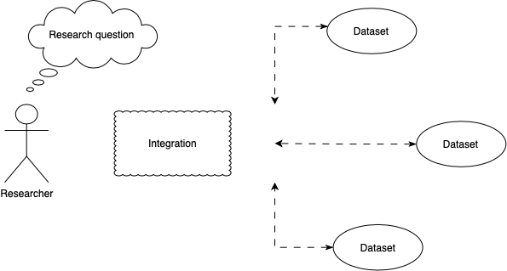
GeoSocial
Problem: The researchers want to bring data on people and places together, but don’t know how to do it and what the issues might be.
Notes:
Explain that is more complicated that just merging data.

Slide 5
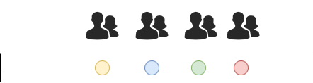
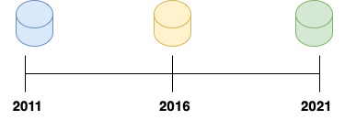

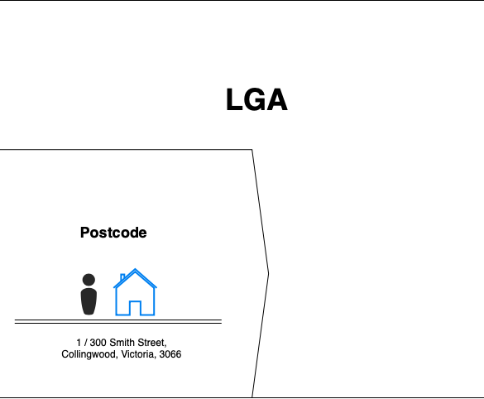

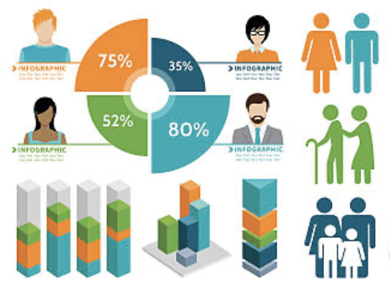


Motivation
The GeoSocial solution allows researchers to link Australia’s largest longitudinal surveys with geospatial statistical data derived from the Australian Census of Population and Housing. GeoSocial will empower Australia's large cross-disciplinary social research community to identify patterns, make predictions, and inform social policy using rich integrated GeoSocial data.
Longitudinal data
Socio-demographic characteristics
Data custodians
Notes:
Longitudinal surveys contain geographical identifiers (sensitive data). -> Extra risk.
Data custodians have strict standards and procedures to access the data.
Each new user needs to get approval to access the data and satisfy the requirements.
The solution is designed to allow researchers to easily integrate pieces of code into their workflow without interfering with the standards and procedures set by the data custodians.

Slide 6



Personas
During the ISSR-AURIN Workshop held on August 16, 2022, we worked collaboratively to define functional requirements and prioritize them using the Agile method MoSCoW.
Low skills level
Easy access to the data.
Certainty regarding data meanings.
Less room for analytic errors.
Increased data usability and utility to untrained users.
Reduction of the risk of data breaches.
Mid-level user
Advanced user
Confident with understanding and tweaking R scripts
Experienced in the use of Stata software
Limited understanding of geospatial data
Needs to integrate longitudinal and geospatial data for analysis
May consult with data science researchers to achieve goals
Confident with using Python and/or R for data wrangling, integration, and analysis
Good understanding of geospatial data
Needs to integrate longitudinal and geospatial data for analysis
Supports other social science researchers
Notes:
Stands for “must-have,” “should-have,” “could-have,” and “won't-have”

Slide 7
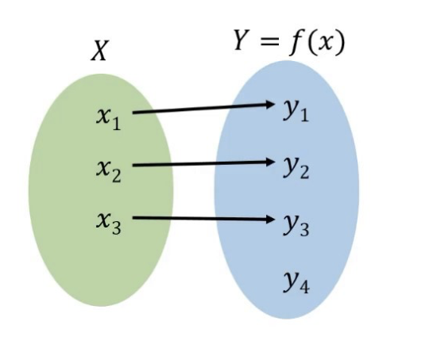

Considerations
Additional Considerations
Concordance/Correspondence
Comparison between two spatial variables collected in two different moments of the time.
Semantic
Classifications and vocabularies change with time and are not in a machine-readable format.

Slide 8
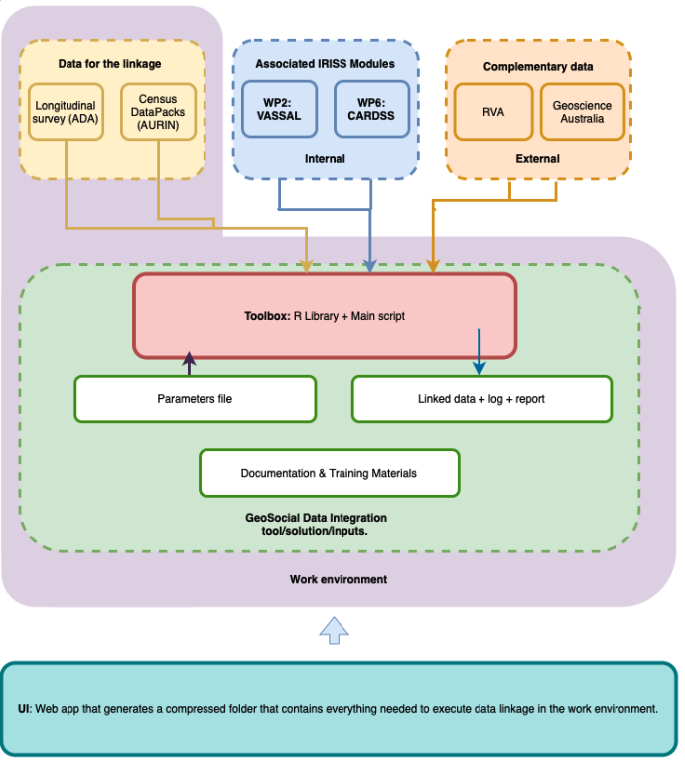
Preliminary GeoSocial service design
Key Features of GeoSocial:
Designed to meet the needs of mid to advanced users.
Does not interfere with data custodian requirements.
Interoperable and can connect with other work packages.
Offers transparency and a high level of personalization.
Built using the FAIR Principles for Research Software.

Slide 9


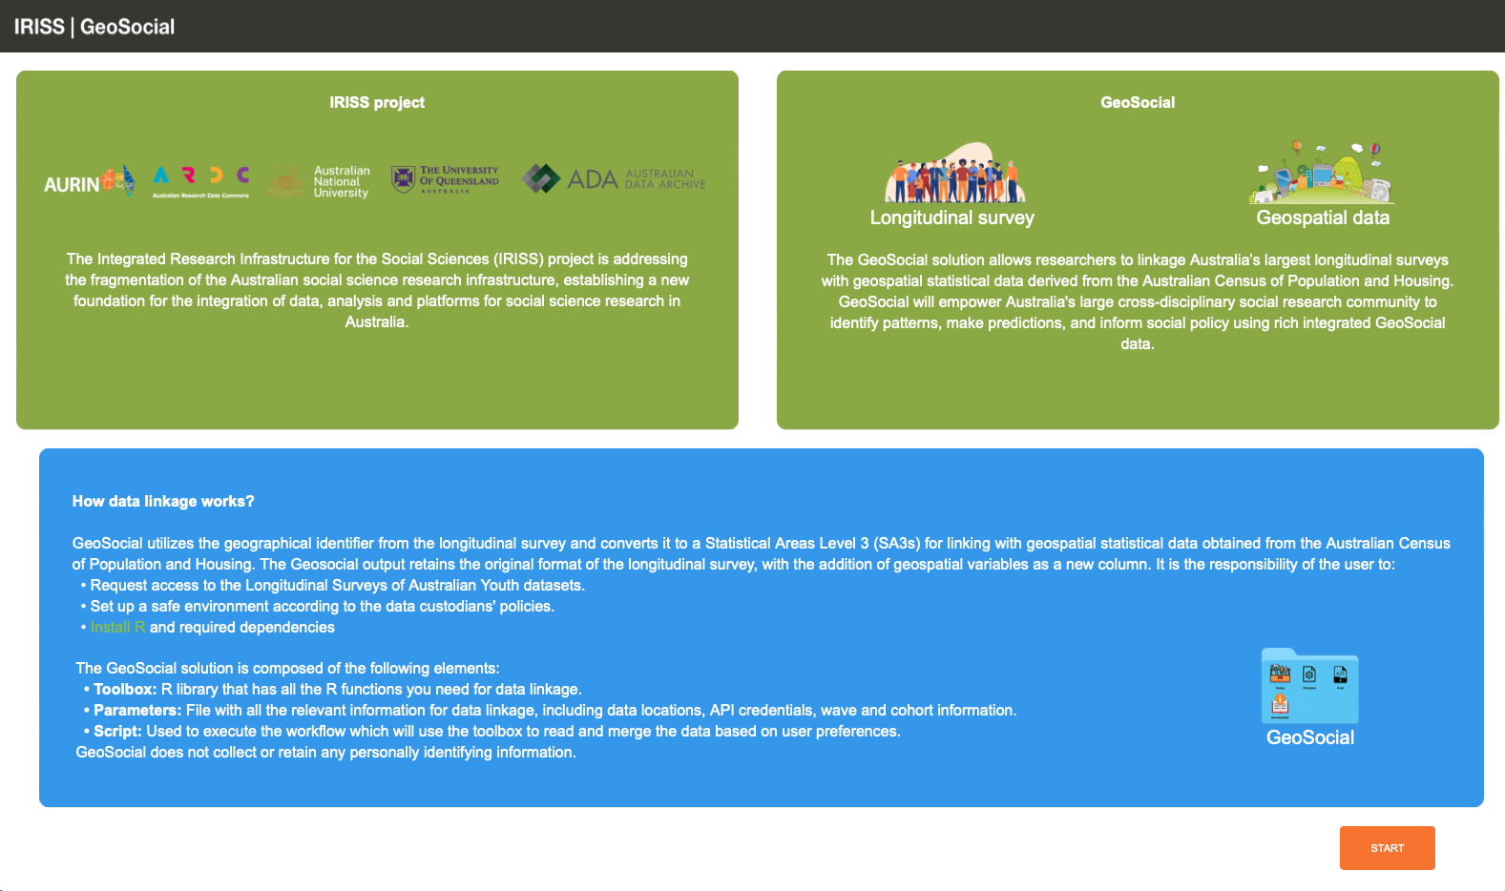
Demonstrator:
Longitudinal Survey: LSAY 2009
Geospatial dataset: Time series profile 2021

Slide 10




Interface:
Demo: http://203.101.231.244
Github: https://github.com/AURIN-OFFICE/geosocial

Slide 11
Thank you

